Slide 1
Nonlinear Equations

Slide 2
Topics
Characterization of problems
Bisection method
Iterative methods for solving nonlinear problems
Fixed point method – general idea
Convergence criteria
Newton Methods and its variances
Convergence of the Exact Newton methods
System of nonlinear equations

Slide 3
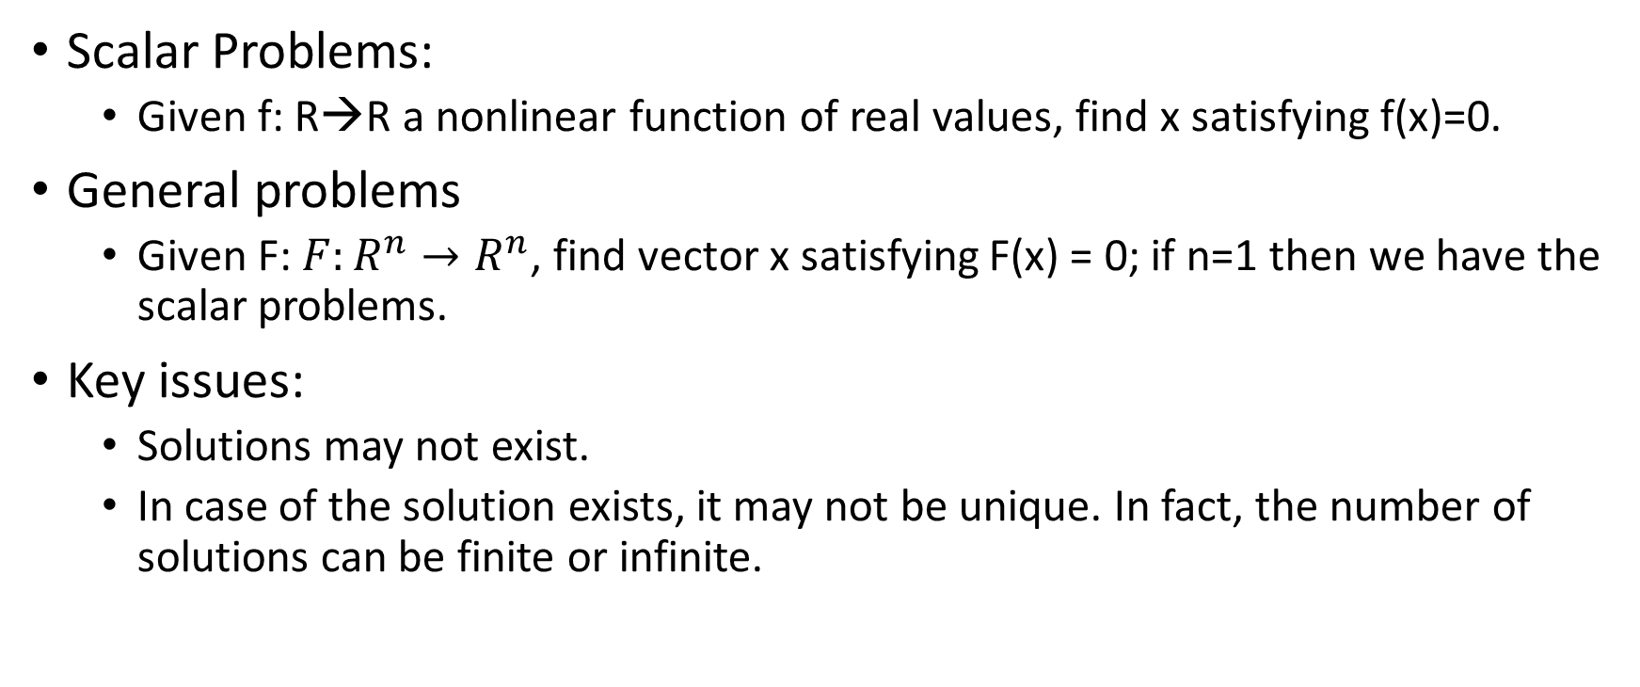
Characterization of Nonlinear Problems
Scalar Problems:
Given f: R→R a nonlinear function of real values, find x satisfying f(x)=0.
General problems
Given F: $F:R^{n}→R^{n}$, find vector x satisfying F(x) = 0; if n=1 then we have the scalar problems.
Key issues:
Solutions may not exist.
In case of the solution exists, it may not be unique. In fact, the number of solutions can be finite or infinite.

Slide 4
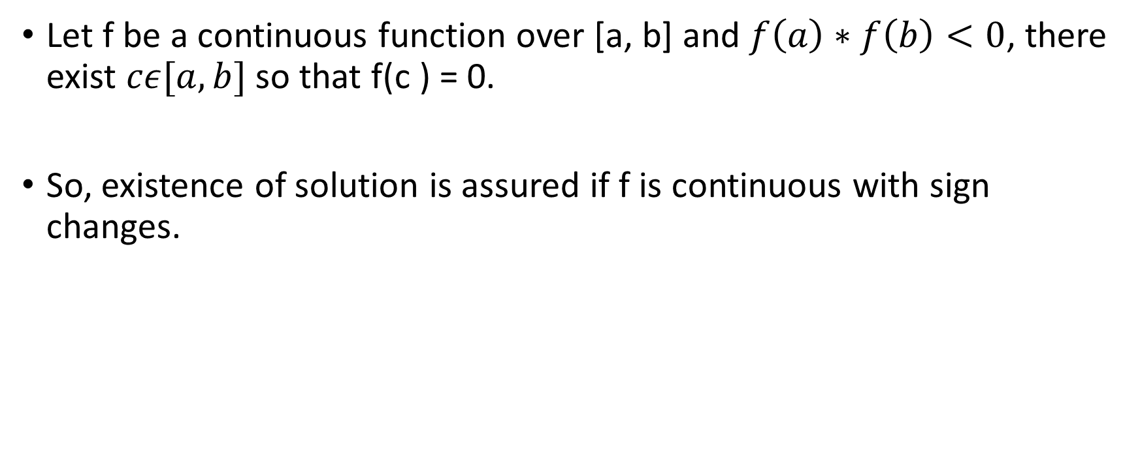
Intermediate Value Theorem
Let f be a continuous function over [a, b] and $f\left(a\right)∗f\left(b\right)<0$, there exist $cε[a,b]$ so that f(c ) = 0.
So, existence of solution is assured if f is continuous with sign changes.

Slide 5

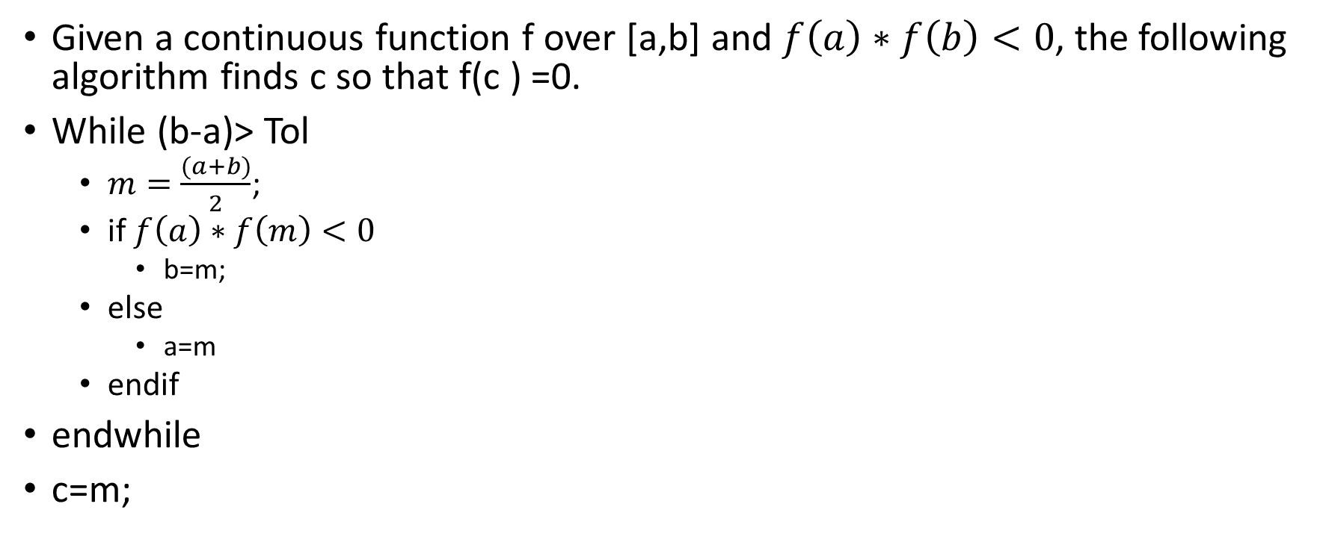
Bisection method
Given a continuous function f over [a,b] and $f\left(a\right)∗f\left(b\right)<0$, the following algorithm finds c so that f(c ) =0.
While (b-a)> Tol
$m=\frac{(a+b)}{2}$;
if $f\left(a\right)∗f\left(m\right)<0$
b=m;
else
a=m
endif
endwhile
c=m;
For the given user-tolerance Tol, the solution c will be found after n iterations where $n=\left\lceil \log_{2}{\frac{(b−a)}{Tol}}\right\rceil$

Slide 6
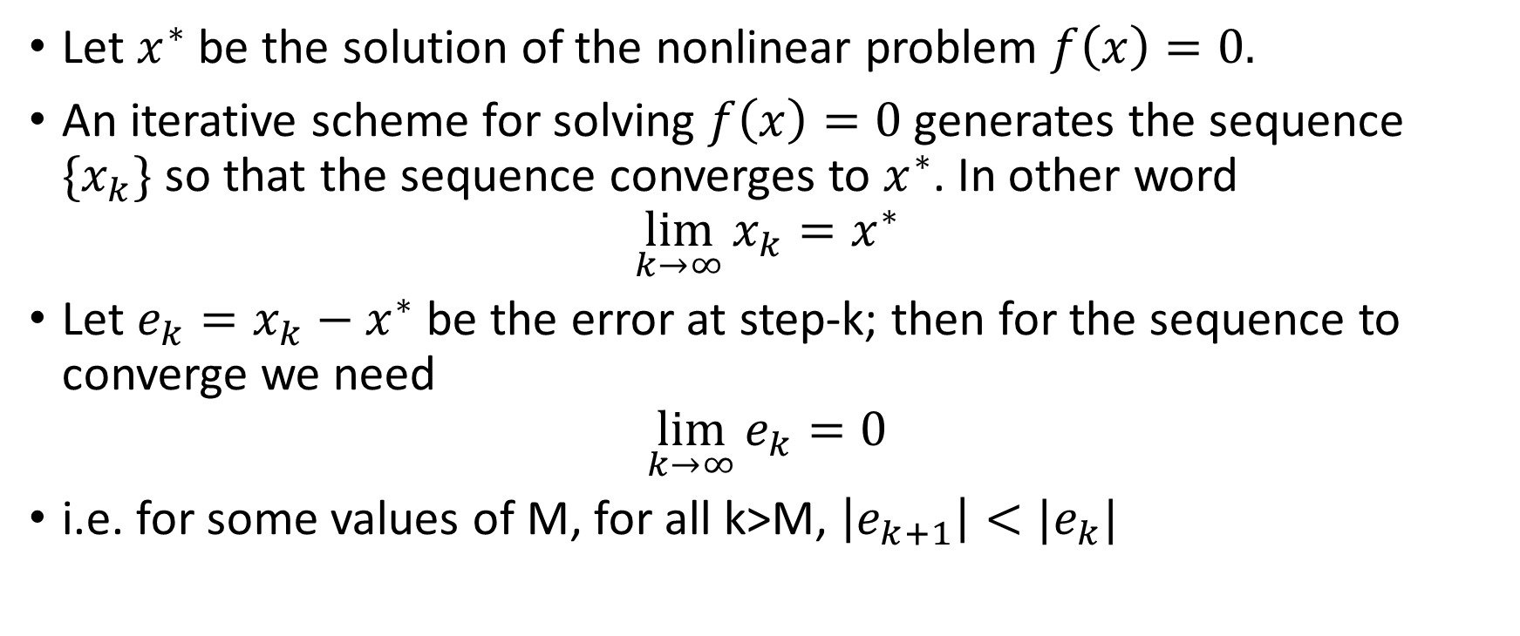

Iterative Methods – a general approach
Let $x^{∗}$ be the solution of the nonlinear problem $f\left(x\right)=0.$
An iterative scheme for solving $f\left(x\right)=0$ generates the sequence $\{x_{k}\}$ so that the sequence converges to $x^{∗}$. In other word
$$\lim_{k→∞}{x_{k}=x^{∗}}$$
Let $e_{k}=x_{k}−x^{∗}$ be the error at step-k; then for the sequence to converge we need
$$\lim_{k→∞}{e_{k}=0}$$
i.e. for some values of M, for all k>M, $\left|e_{k+1}\right|<|e_{k}|$

Slide 7
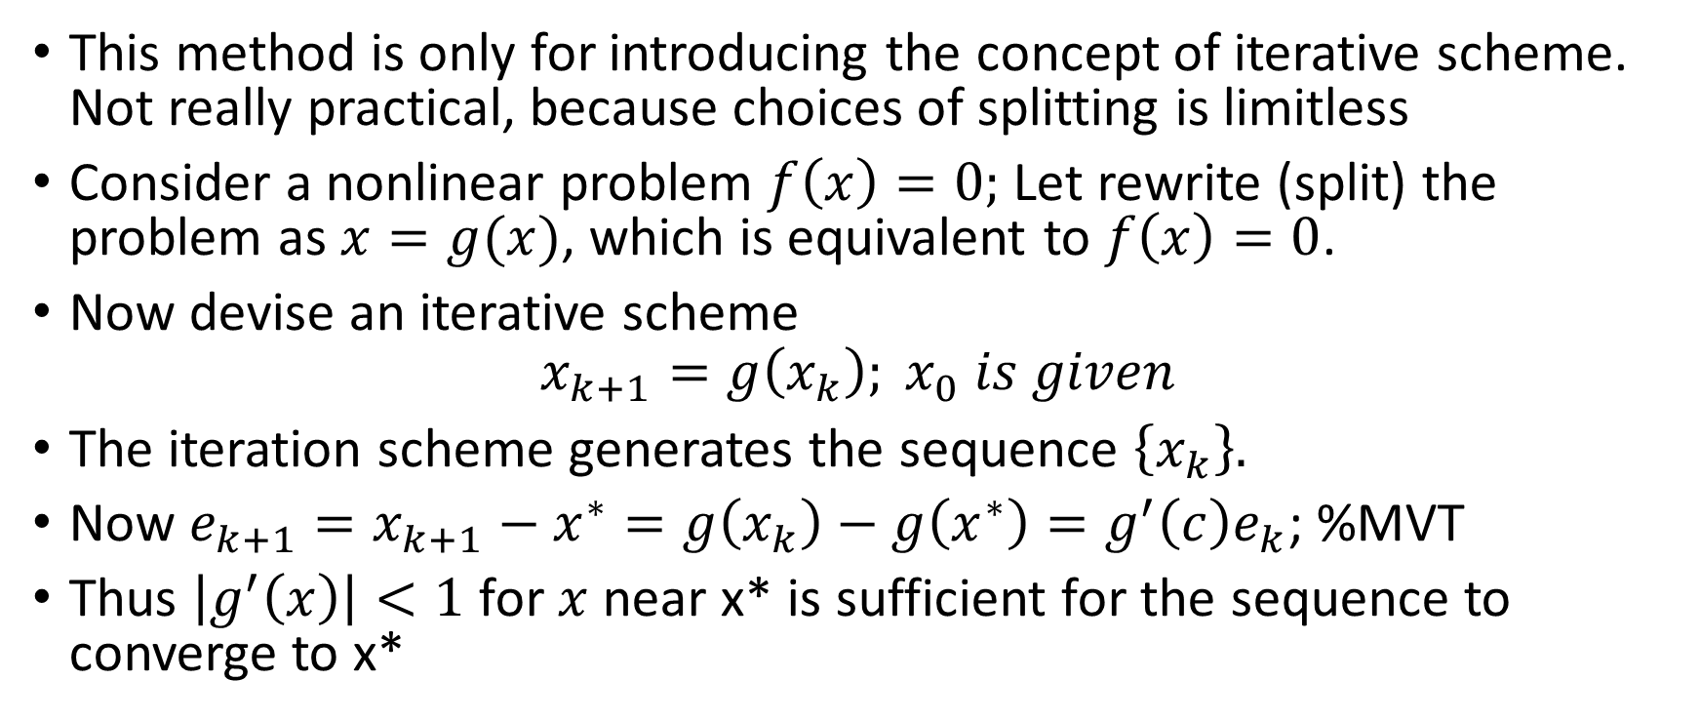
Fixed-Point (Splittng Method)
This method is only for introducing the concept of iterative scheme. Not really practical, because choices of splitting is limitless
Consider a nonlinear problem $f\left(x\right)=0;$ Let rewrite (split) the problem as $x=g(x)$, which is equivalent to $f\left(x\right)=0$.
Now devise an iterative scheme
$$x_{k+1}=g\left(x_{k}\right); x_{0} is given$$
The iteration scheme generates the sequence $\left\{x_{k}\right\}.$
Now $e_{k+1}=x_{k+1}−x^{∗}=g\left(x_{k}\right)−g\left(x^{∗}\right)=g^{′}\left(c\right)e_{k}$; %MVT
Thus $\left|g^{′}\left(x\right)\right|<1$ for $x$ near x* is sufficient for the sequence to converge to x*

Slide 8
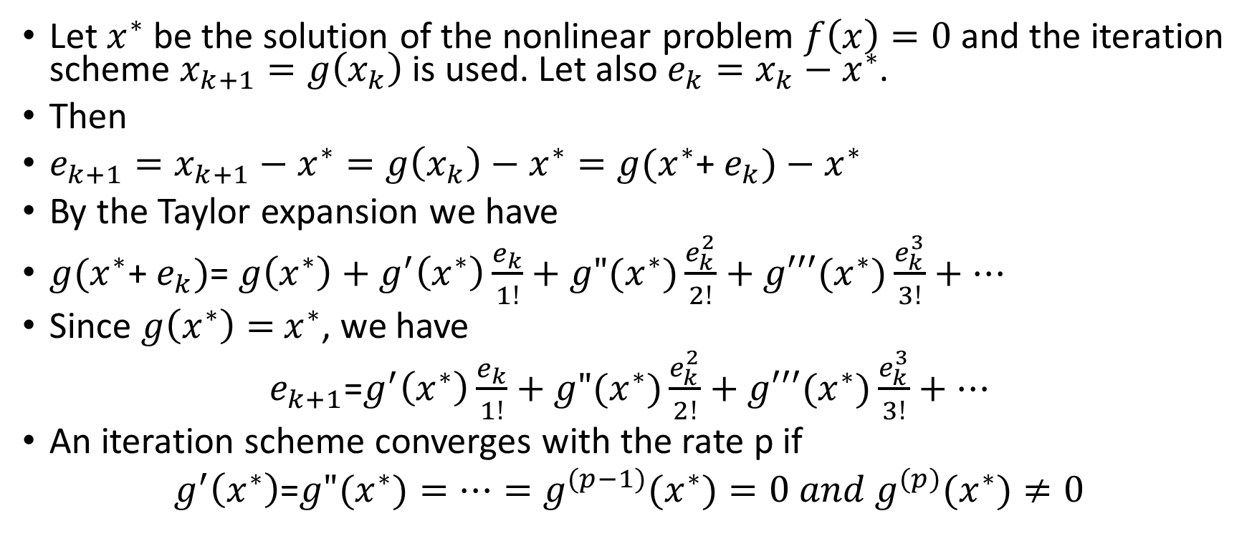
Convergence Rate
Let $x^{∗}$ be the solution of the nonlinear problem $f\left(x\right)=0$ and the iteration scheme $x_{k+1}=g\left(x_{k}\right)$ is used. Let also $e_{k}=x_{k}−x^{∗}$.
Then
$e_{k+1}=x_{k+1}−x^{∗}=g\left(x_{k}\right)−x^{∗}=g(x^{∗}$+ $e_{k})−$ $x^{∗}$
By the Taylor expansion we have
$g(x^{∗}$+ $e_{k})$= $g\left(x^{∗}\right)+g^{′}\left(x^{∗}\right)\frac{e_{k}}{1!}+g"(x^{∗})\frac{e_{k}^{2}}{2!}+g′′′(x^{∗})\frac{e_{k}^{3}}{3!}+…$
Since $g\left(x^{∗}\right)=$ $x^{∗}$, we have
$e_{k+1}$=$g^{′}\left(x^{∗}\right)\frac{e_{k}}{1!}+g"(x^{∗})\frac{e_{k}^{2}}{2!}+g′′′(x^{∗})\frac{e_{k}^{3}}{3!}+…$
An iteration scheme converges with the rate p if
$g^{′}\left(x^{∗}\right)$=$g"(x^{∗})=…=g^{(p−1)}(x^{∗})=0 and g^{(p)}(x^{∗})≠0$

Slide 9
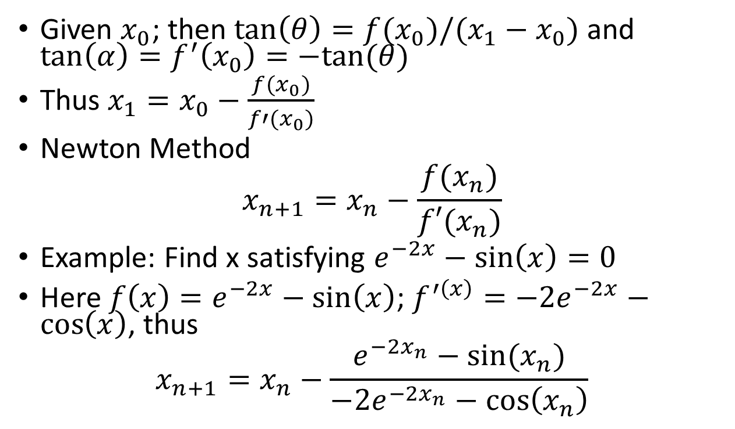
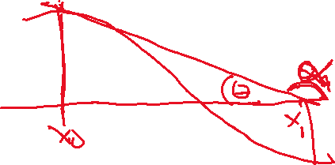
Newton Method
Given $x_{0}$; then $\tan\left(θ\right)=f(x_{0})/(x_{1}−x_{0})$ and $\tan\left(α\right)=f^{′}\left(x_{0}\right)=−tan⁡(θ)$
Thus $x_{1}=x_{0}−\frac{f(x_{0})}{f′(x_{0})}$
Newton Method
$$x_{n+1}=x_{n}−\frac{f(x_{n})}{f′(x_{n})}$$
Example: Find x satisfying $e^{−2x}−\sin\left(x\right)=0$
Here ${f\left(x\right)=e}^{−2x}−\sin\left(x\right)$; ${f^{′\left(x\right)}=−2e}^{−2x}−\cos\left(x\right)$, thus
$$x_{n+1}=x_{n}−\frac{e^{−2x_{n}}−sin⁡(x_{n})}{{−2e}^{−2x_{n}}−\cos\left(x_{n}\right)}$$

Slide 10
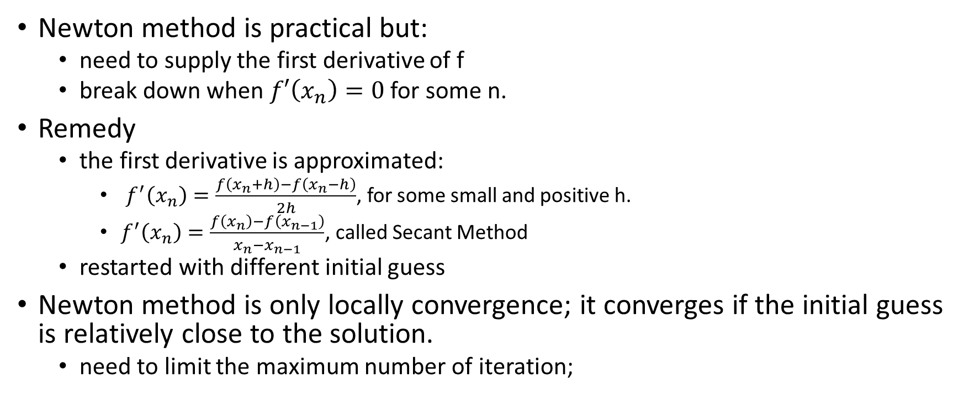
Implementation issues
Newton method is practical but:
need to supply the first derivative of f
break down when $f′\left(x_{n}\right)=0$ for some n.
Remedy
the first derivative is approximated:
$f^{′}\left(x_{n}\right)=\frac{f\left(x_{n}+h\right)−f\left(x_{n}−h\right)}{2h}$, for some small and positive h.
$f^{′}\left(x_{n}\right)=\frac{f\left(x_{n}\right)−f\left(x_{n−1}\right)}{x_{n}−x_{n−1}}$, called Secant Method
restarted with different initial guess
Newton method is only locally convergence; it converges if the initial guess is relatively close to the solution.
need to limit the maximum number of iteration;

Slide 11
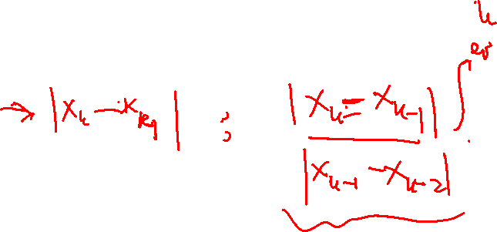
Newton Algorithm
function x0 = Newton(x0,tol,itmax)
f0=f(x0); h=10^-5;
iter=0;
while abs(f0)>tol && iter<itmax
df0= df(x0); % alternative: df0=(f(x0+h)-f(x0-h))/(2*h);
x0=x0-f0/df0;
f0=f(x0);
iter=iter+1;
end

Slide 12
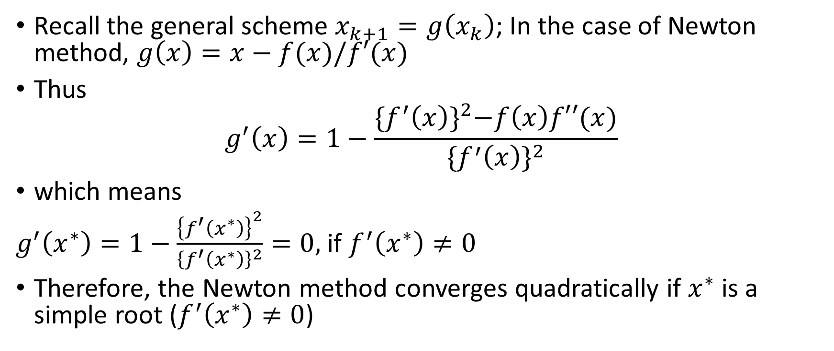
Convergence rate of Newton Method
Recall the general scheme $x_{k+1}=g\left(x_{k}\right)$; In the case of Newton method, $g\left(x\right)=x−f(x)/f′(x)$
Thus
$$g^{′}\left(x\right)=1−\frac{{\{f^{′}\left(x\right)\}}^{2}−f\left(x\right)f′′(x)}{{\{f^{′}\left(x\right)\}}^{2}}$$
which means
$g^{′}\left(x^{∗}\right)=1−\frac{{\left\{f^{′}\left(x^{∗}\right)\right\}}^{2}}{{\left\{f^{′}\left(x^{∗}\right)\right\}}^{2}}=0,$ if $f^{′}\left(x^{∗}\right)≠0$
Therefore, the Newton method converges quadratically if $x^{∗}$ is a simple root ($f^{′}\left(x^{∗}\right)≠0$)

Slide 13
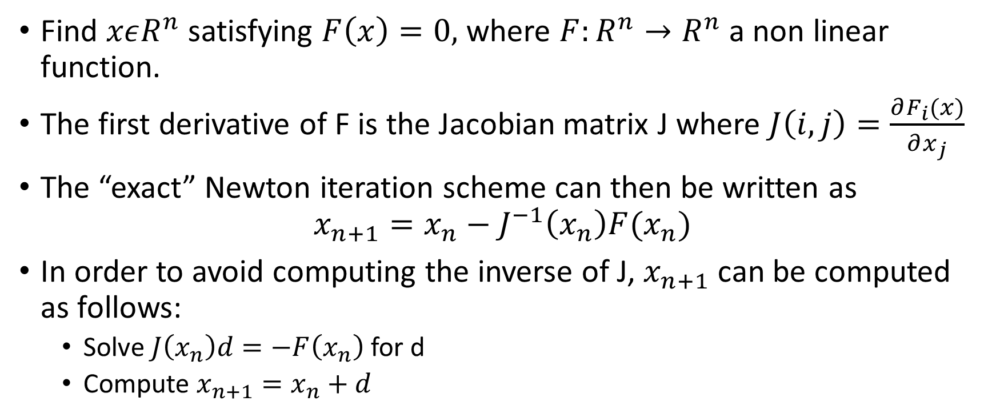
System of Nonlinear Equations
Find $xεR^{n}$ satisfying $F\left(x\right)=0,$ where $F:R^{n}→R^{n}$ a non linear function.
The first derivative of F is the Jacobian matrix J where $J\left(i,j\right)=\frac{∂F_{i}(x)}{∂x_{j}}$
The “exact” Newton iteration scheme can then be written as
$$x_{n+1}=x_{n}−J^{−1}\left(x_{n}\right)F(x_{n})$$
In order to avoid computing the inverse of J, $x_{n+1}$ can be computed as follows:
Solve $J\left(x_{n}\right)d=−F\left(x_{n}\right)$ for d
Compute $x_{n+1}=x_{n}+d$

Slide 14
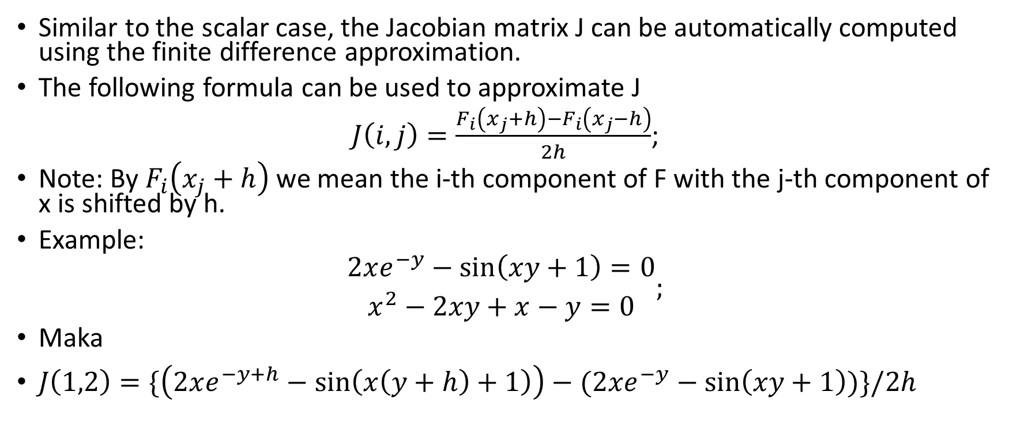
Computing the Jacobian J
Similar to the scalar case, the Jacobian matrix J can be automatically computed using the finite difference approximation.
The following formula can be used to approximate J
$J\left(i,j\right)=\frac{F_{i}\left(x_{j}+h\right)−F_{i}\left(x_{j}−h\right)}{2h}$;
Note: By $F_{i}\left(x_{j}+h\right)$ we mean the i-th component of F with the j-th component of x is shifted by h.
Example:
$\begin{matrix}2xe^{−y}−\sin\left(xy+1\right)=0 \\ x^{2}−2xy+x−y=0\end{matrix};$
Maka
$J\left(1,2\right)=\{\left(2xe^{−y+h}−\sin\left(x\left(y+h\right)+1\right)\right)−(2xe^{−y}−\sin\left(xy+1\right))\}/2h$

Slide 15

Matlab function for computing J
function J=Jacobian(x0)
h=10^-5;
n=length(x0);
for i=1:n
for j=1:n
x0jph=x0; x0jph(j)=x0jph(j)+h;
x0jmh=x0;x0jmh(j)=x0jmh(j)-h;
F0jph=Fx(x0jph); F0jmh=Fx(x0jmh);
J(i,j)=(F0jph(i)-F0jmh(i))/(2*h);
end
end

Slide 16

Newton Algorithm for system of NLE
Initial guess x0;
Compute F0 and J0
while norm(F0)> Tol & iter<itmax
solve J0 d= - F0
update x0 = x0+d;
update F0 & J0;
iter +=1;
end

Slide 17
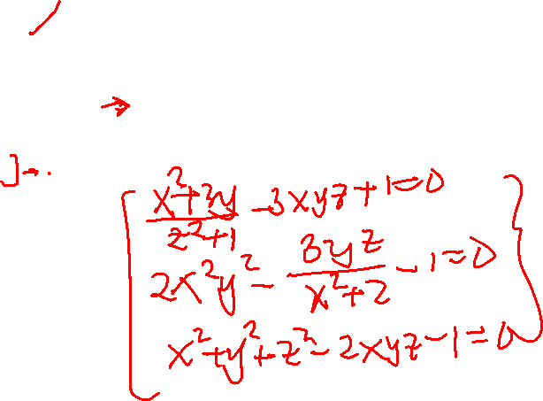
Chord-Method: Update Jacobi at each M iterations
Initial guess x0;
Compute F0 and J0
while norm(F0)> Tol & iter<itmax
factorize J0: [L,U,p]=lu(J0);
for k=1:M
solve Ly = -F0(p);
solve Ud=y;
update x0 = x0+d;
update F0
iter +=1;
end
update J0;
end

